Slide 1
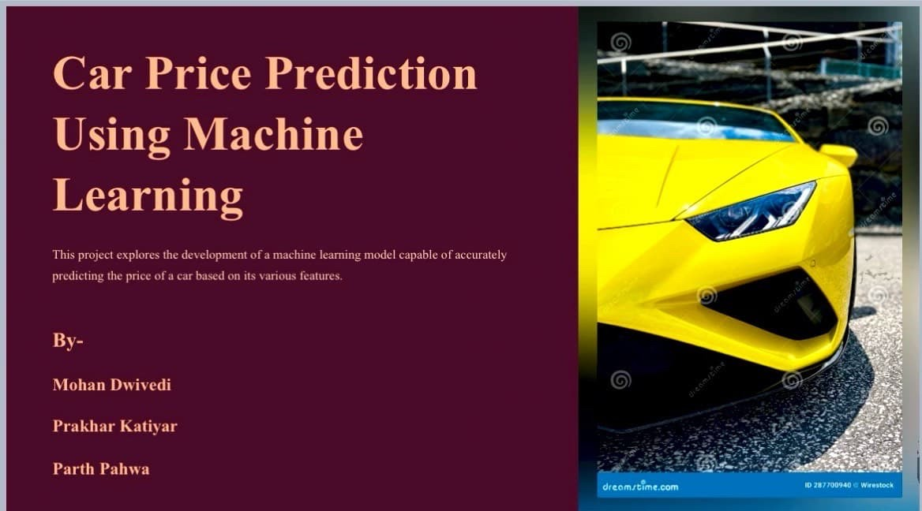

Slide 2
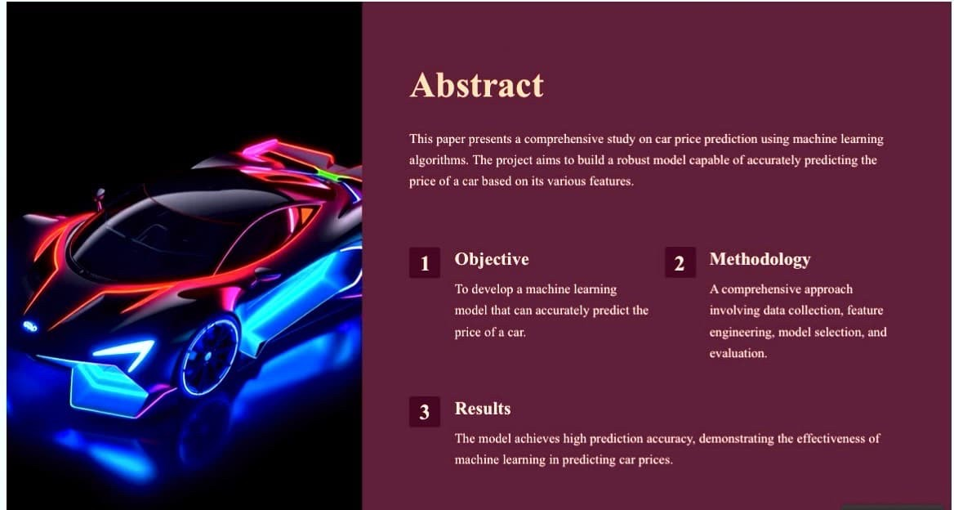

Slide 3
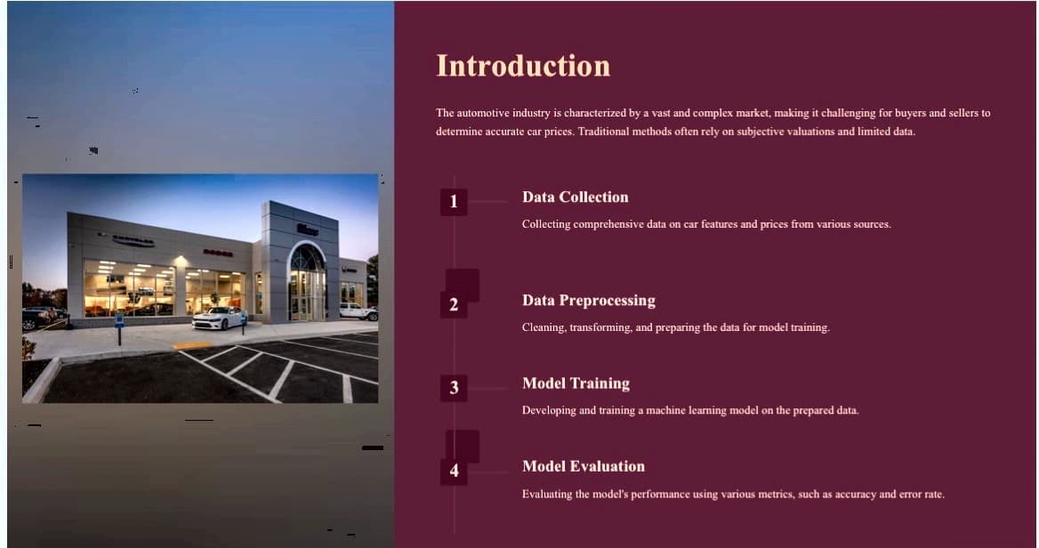

Slide 4
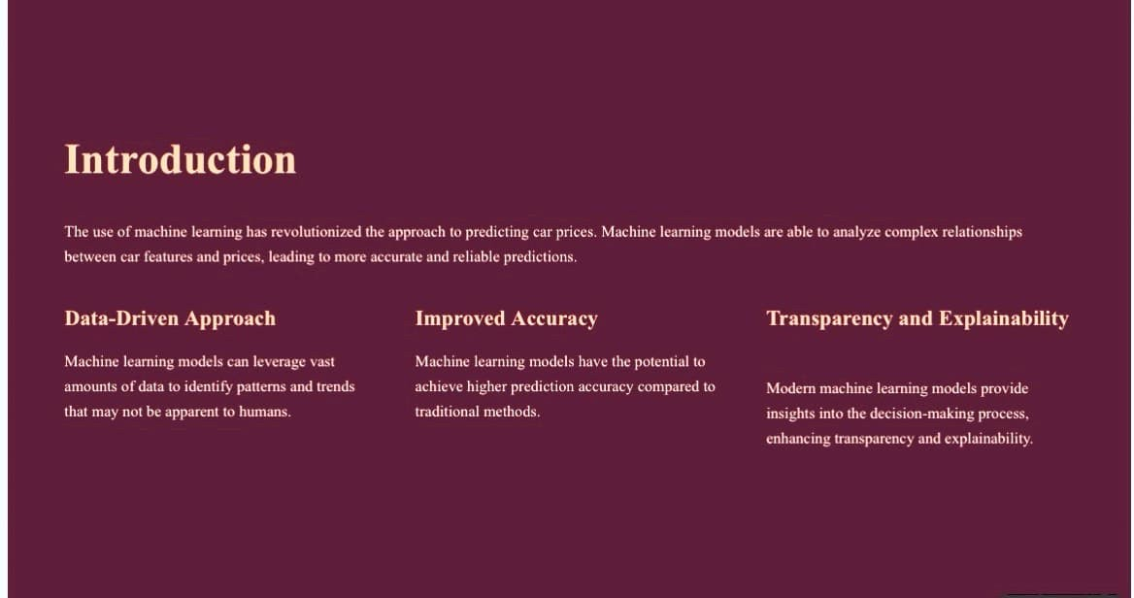

Slide 5
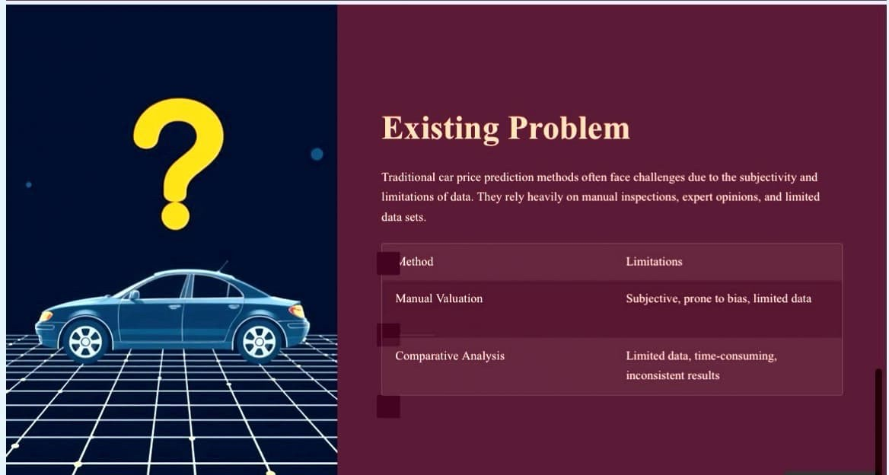

Slide 6
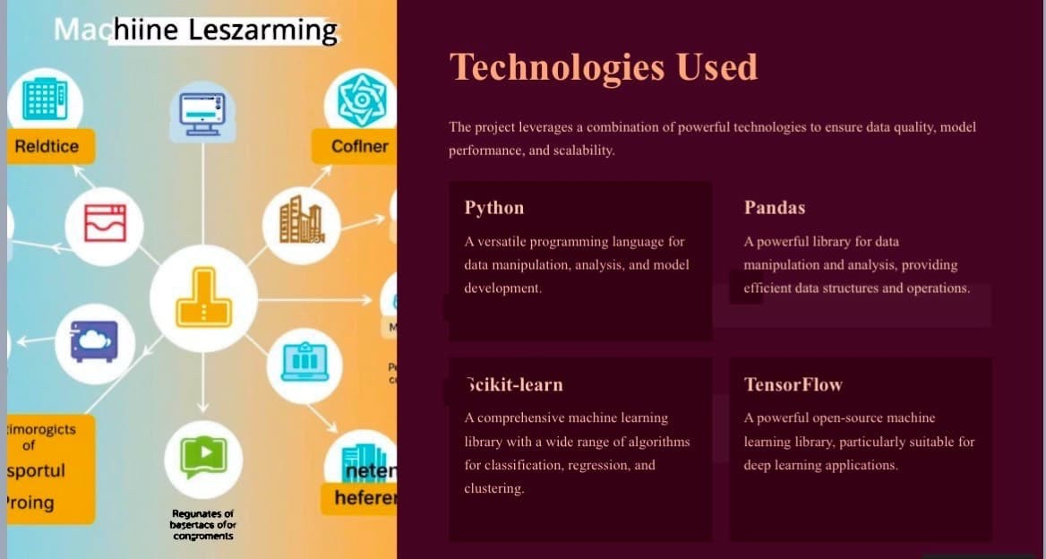

Slide 7
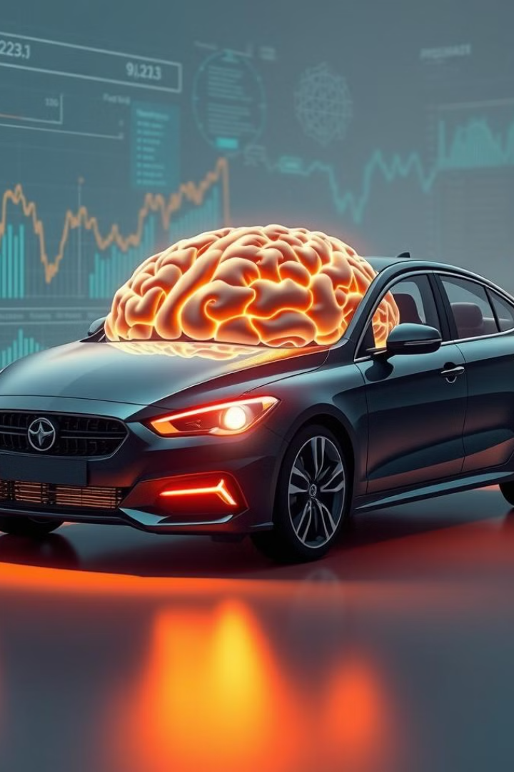




Proposed Solutions
The proposed solution utilizes machine learning algorithms to overcome the limitations of traditional methods and build a robust and accurate car price prediction model.
Collecting comprehensive data from various sources, including car manufacturers, dealerships, and online platforms.
Feature Engineering
Creating relevant features from raw data, such as make, model, year, mileage, engine size, and condition.
Model Selection
Choosing an appropriate machine learning model, such as linear regression, decision trees, or neural networks.
Model Training
Training the selected model on the prepared data to learn the relationships between features and prices.

Slide 8
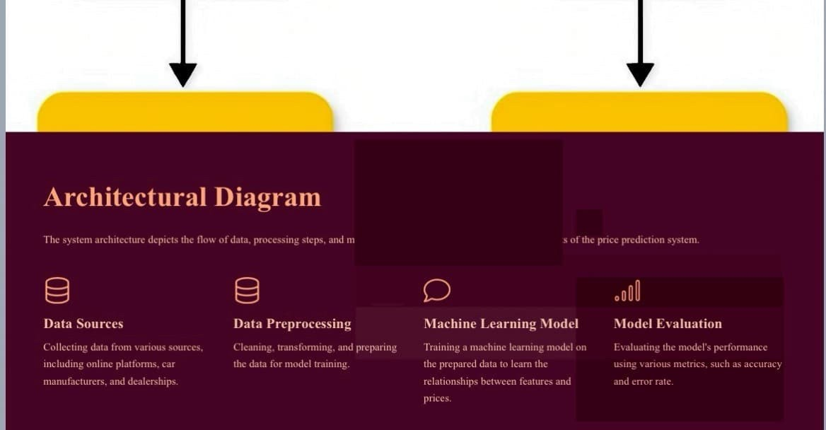

Slide 9
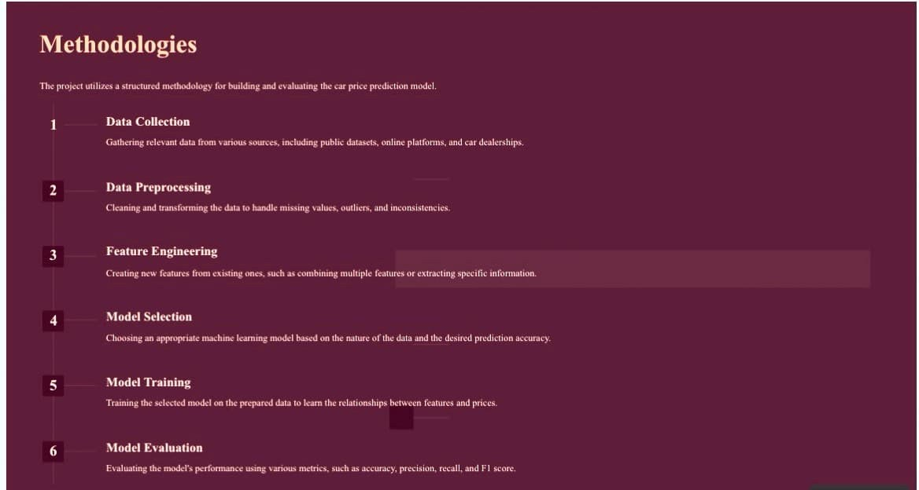

Slide 10
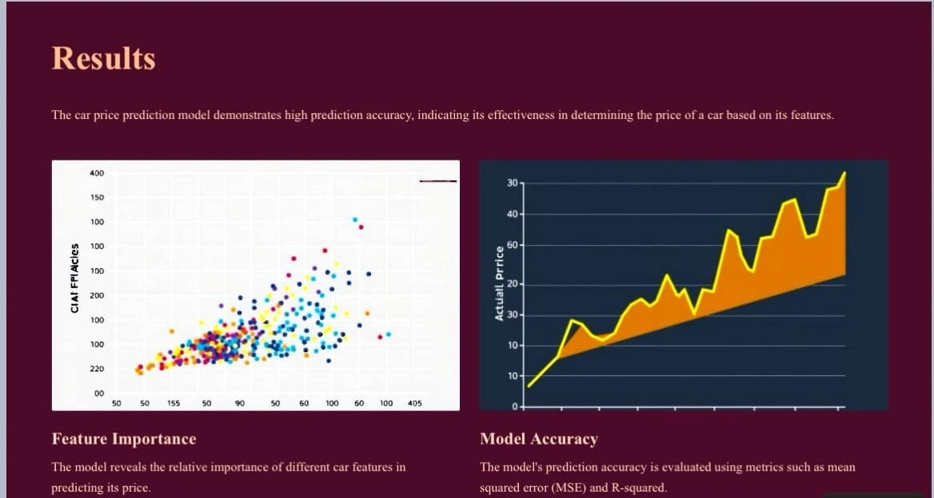

Slide 11
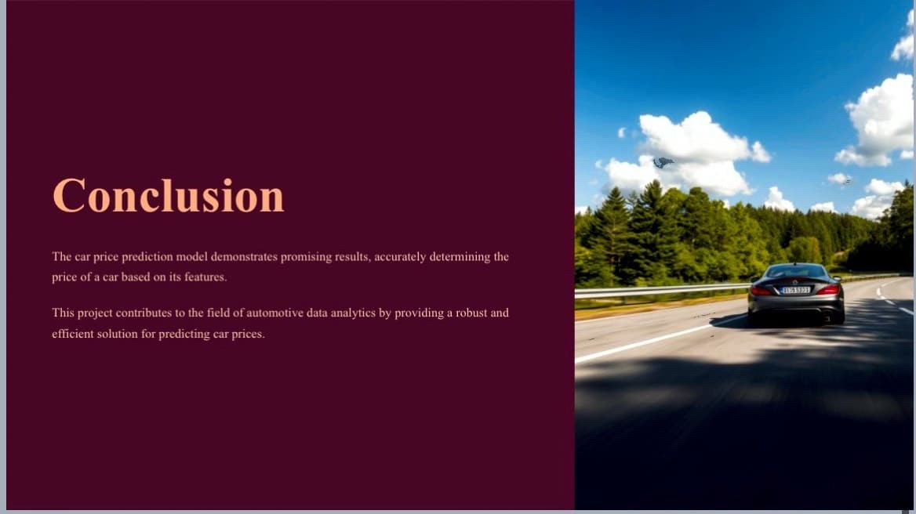

Slide 12
